Slide 1
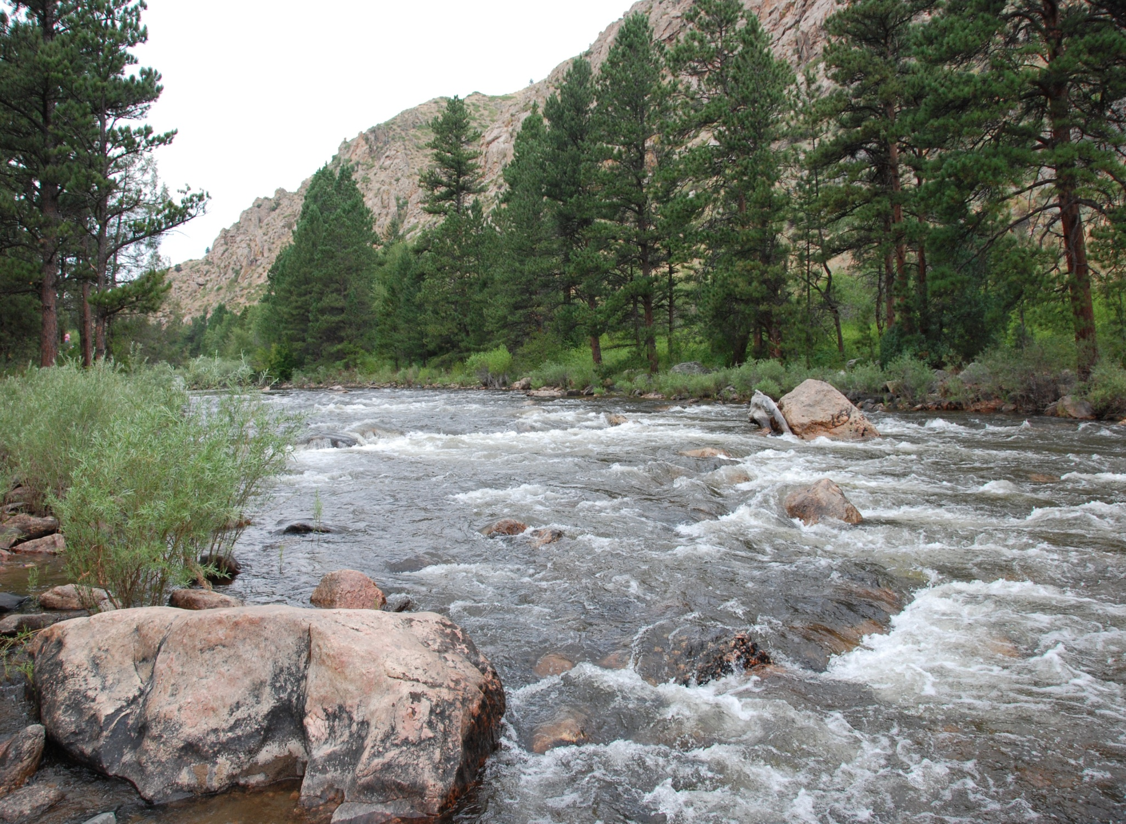
Northern Integrated Supply Project
NSPE-Colorado State Meeting
February 2010

Slide 2
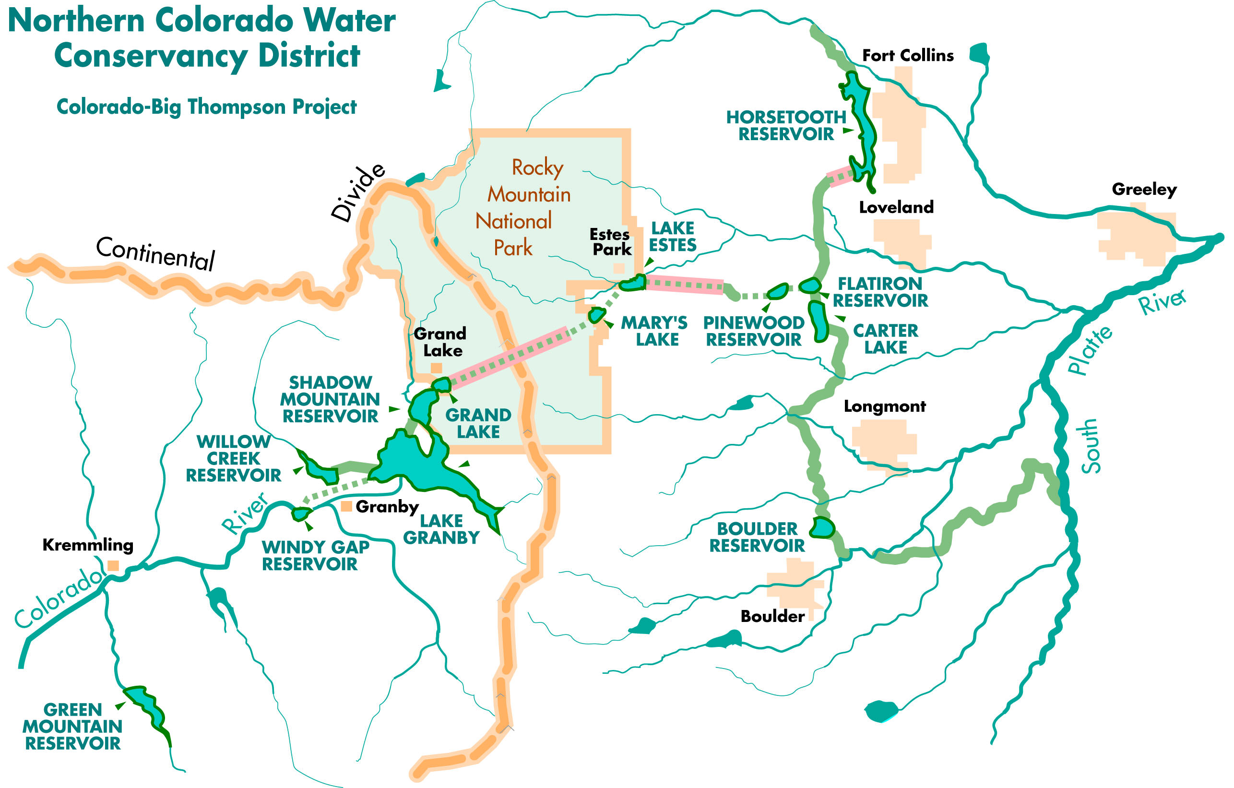
Who is Northern Water?

Slide 3
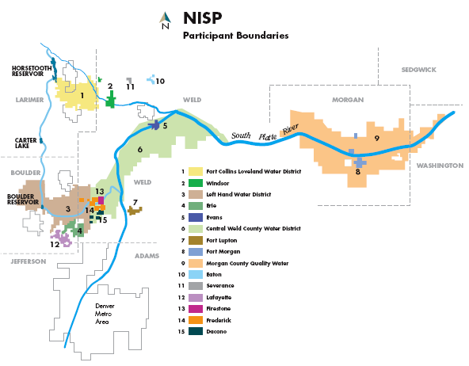
NISP – A Participant Driven Project

Slide 4
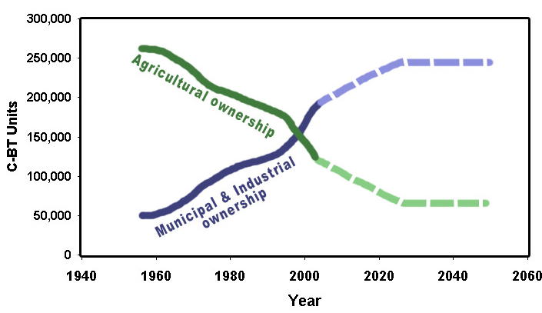
C-BT Ownership Trends

Slide 5
Participant Supply and Demand

Slide 6
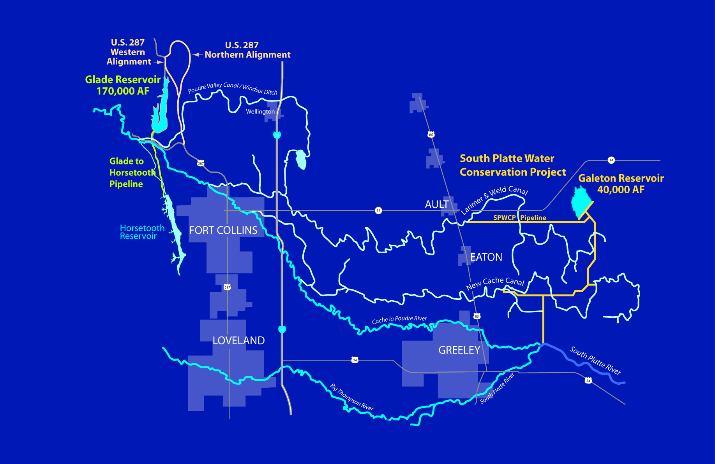
The NISP Proposal:

Slide 7
NISP Project Proposal
40,000 Acre-ft of New Yield
Glade Reservoir Complex
South Platte Water Conservation Project
Total Cost $490 Million
Junior Water Rights

Slide 8
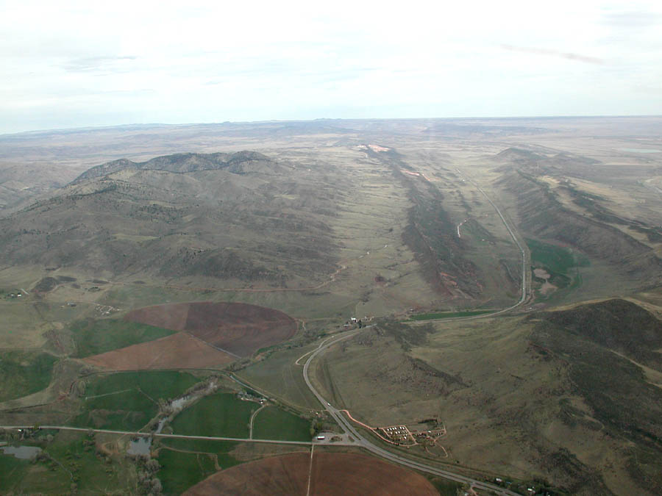
Glade Reservoir
Proposed Glade Reservoir Location
Approx. Dam Axis
Hwy 14
Hwy 287

Slide 9
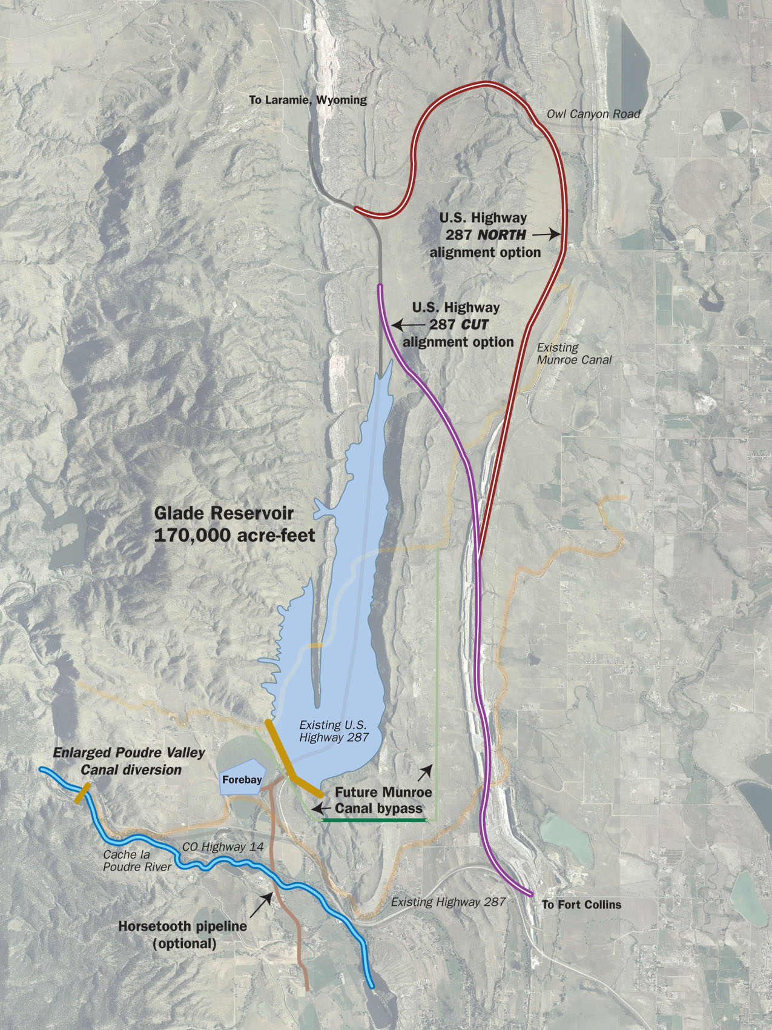
Glade Reservoir
Total storage = 170,000 af
260 feet deep
5 miles long
18 million CY of earthfill
1000 cfs diversion from Poudre River using existing Poudre Valley Canal
30,000 hp Pump Station
Relocate Munroe Canal (6,000 ft Tunnel)
Relocate HW 287

Slide 10
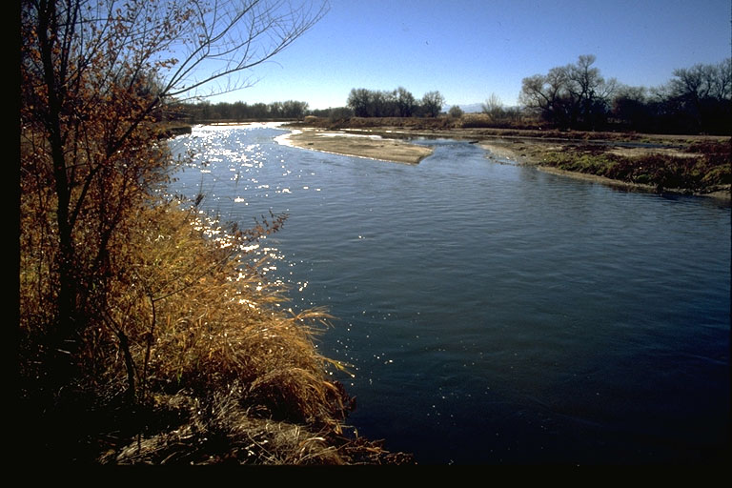
S. Platte Water Conservation Project
60% of the 40,000 Acre-ft Yield
1/3 NISP Cost
Repositions South Platte Water
Partnership with Ag Instead of Buy and Dry
Substantially Reduces Storage to Yield from 10:1 down to 5:1

Slide 11
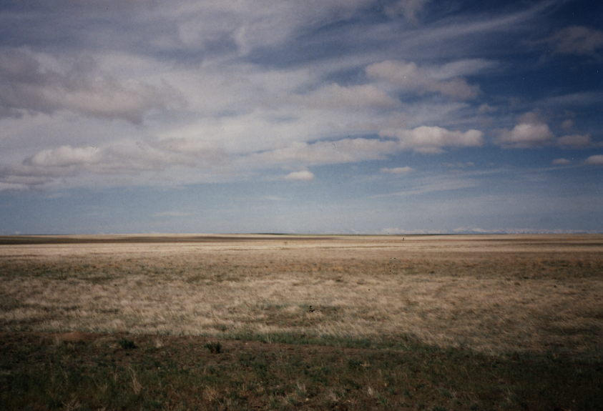
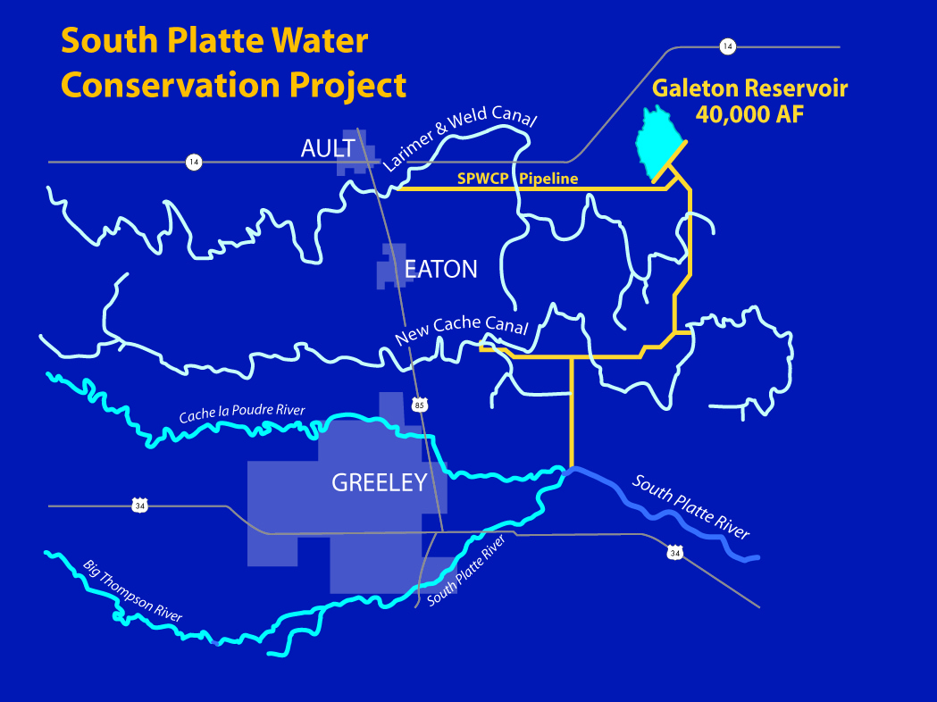
SPWCP Details
45,600 AF Galeton Reservoir
200 cfs Diversion from the South Platte
30 miles of pipeline
16,000 Hp Pumping
Deliveries to New Cache & Larimer and Weld Ditch Systems Average 27,000 af/year

Slide 12
Phased Construction Schedule
TASK | 2003 | 2004 | 2005 | 2006 | 2007 | 2008 | 2009 | 2010 | 2011 | 2012 | 2013 | 2014 | 2015 | 2016 | 2017 | 2018 | 2019 | 2020 | 2021 | 2022
Phase II Alt. Evaluation
NEPA
Galeton Res. Design/Constr
SPWCP Pump & Pipe Design / Construct
HW 287 Design
HW 287 Construction
Glade Design
Glade Construction

Slide 13

NEPA
Started: February 2004
Draft EIS: April 2008
Supplemental DEIS Complete: Mid-2011
Final Permit: 2012
Spent Approximately $8 Million to Date
Estimated EIS Cost of $10 Million

Slide 14
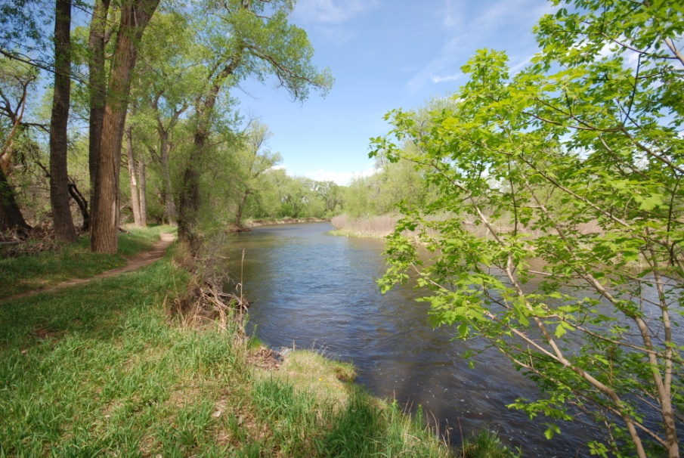
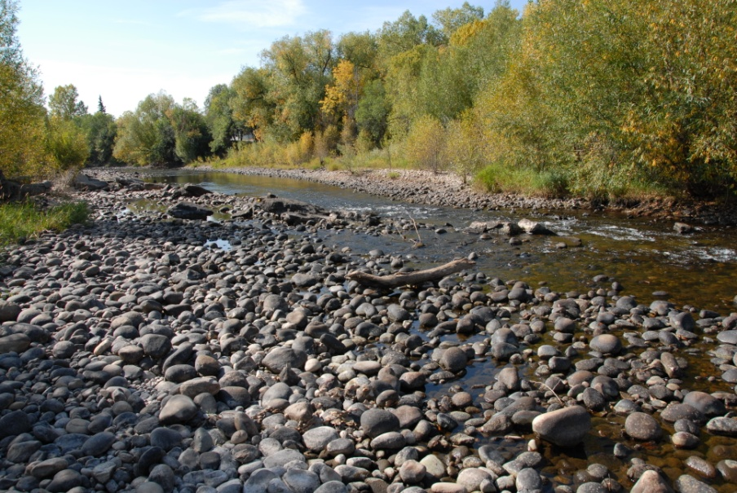
Environmental Issues
Nearly All are Poudre River Related
Flow Reduction
Geomorphology Changes (Sediment)
Water Quality
Riparian (trees)

Slide 15
Lessons Learned
NEPA Takes A LONG Time!
Public Information Matters
Politics (the Yuck Factor)
Be Flexible-Are Enhancements Possible?
Keep Your Sense of Humor!!!!!!!

